Slide 1
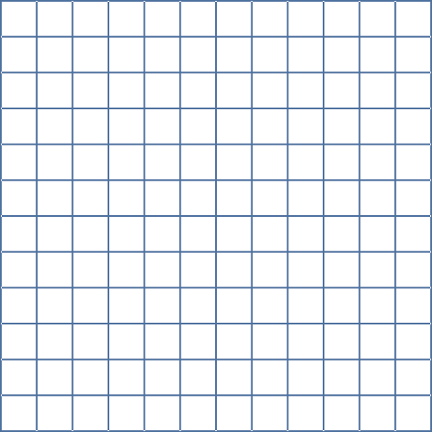


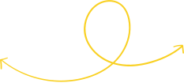





FUNCTIONS LESSON
Mathematics Lesson or Middle School

Slide 2

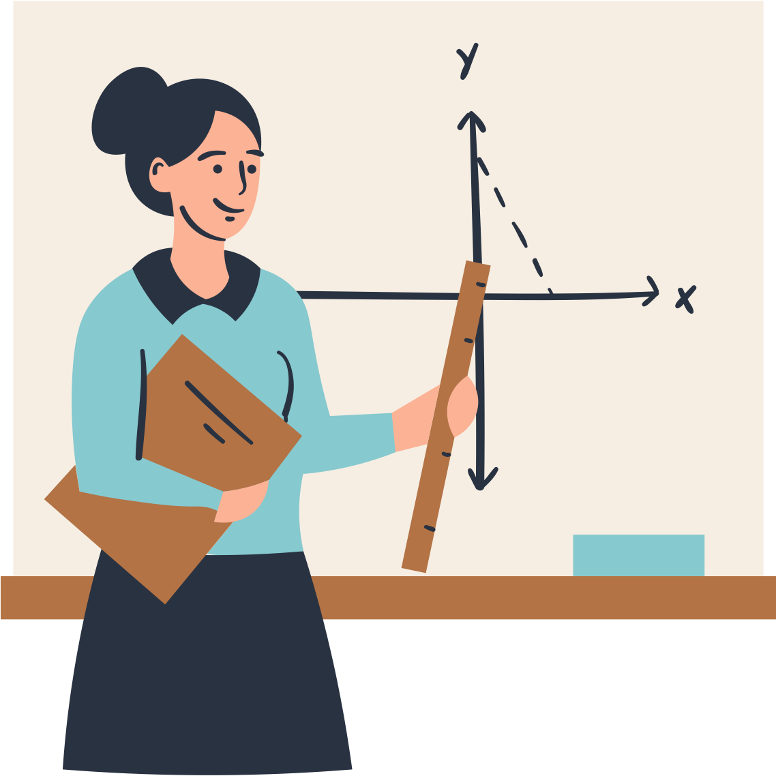



LESSON OUTLINE
What are relations?
What are functions?
Presenting functions as tables and graphs
The Vertical Line Test

Slide 3



LET'S RECALL AND ANALYZE!
y
12
10
Do you still remember how to fill in the table of values based on a given graph?
Complete the table of values below.
8
6
4
2
x
y
x
2
4
6
8
10
12

Slide 4
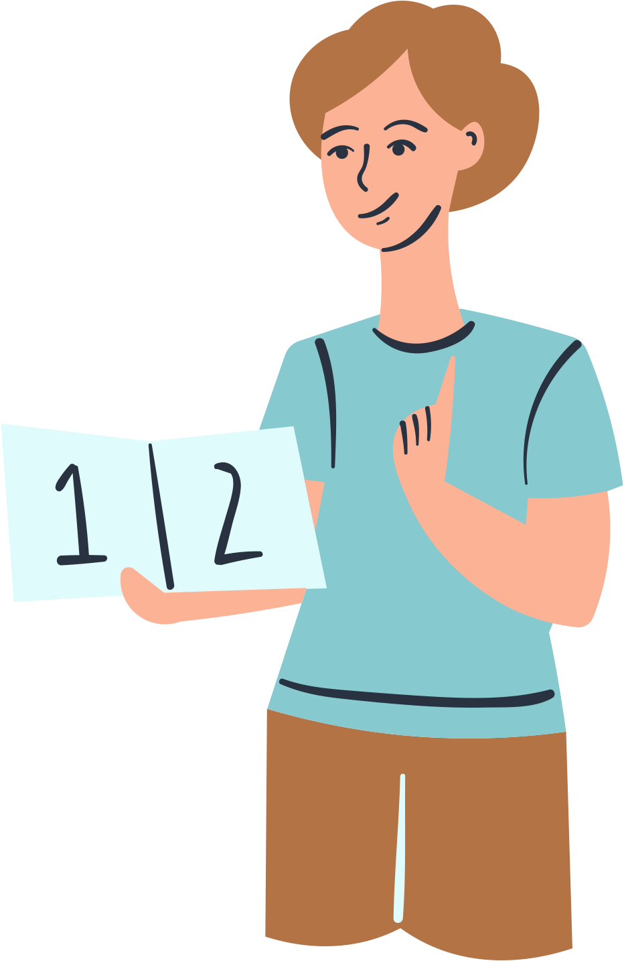
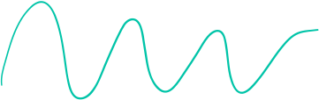
LEARNING OUTCOMES
By the end of the lesson, you'll be able to:
Express relations and functions in tables and graphs.
Differentiate between a relation and a function.
Use a vertical test.

Slide 5





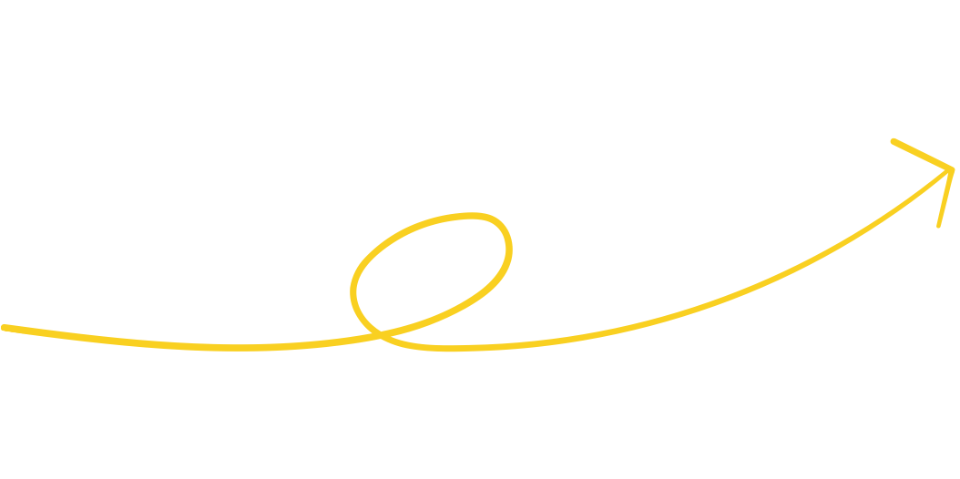
WHAT ARE RELATIONS?
A relation is a set of ordered pairs that represent a relationship.
Example:
Names and their age are a set of ordered pairs that we could put into a table.
Name | Alex | Jude | Arlo | Casey
Age | 9 | 12 | 11 | 11

Slide 6





WHAT IS A FUNCTION?
A function is a special type of relation where each input only has one output.
Functions are a way of connecting inp﻿ut values to their corresponding output values.
The relation is a function if, for every x-value, there is exactly one y-value.

Slide 7

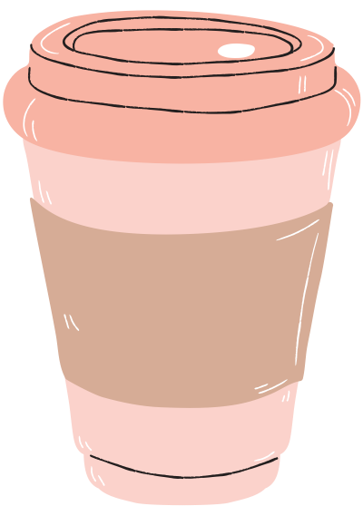
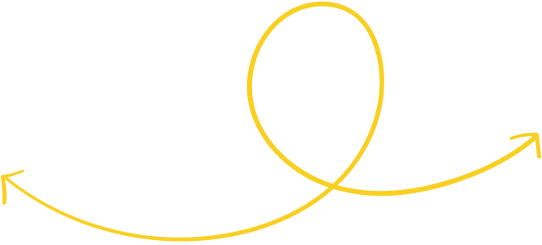
WHAT IS A FUNCTION?
Functions are a way of connecting inp﻿ut values to their corresponding output values.
Example:
Ordering a coffee for $5
Pay $5, and you get 1 coffee.
Pay $10, and you'll get 2 coffees, and so on.
The input affects the output in a predictable way.

Slide 8
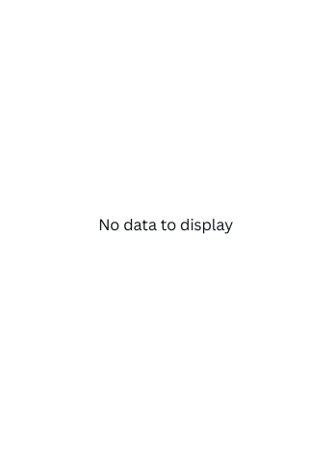
GRAPHING A FUNCTION USING THE TABLE OF VALUES
Step 2:
Given the equation y = 2x.
y
Plot the points.
4
Step 1:
3
Construct the table of values.
2
Do this by substituting values of x to y=2x.
1
x
-1
0
1
2
x | -1 | 0 | 1 | 2
y | -2 | 0 | 2 | 4
-1
-2
Notice that for every value of x, there is only one value of y.

Slide 9


TRY THIS!
Is this relation a function?
x | -6 | -3 | 2 | 7 | 9 | 9 | 10
y | -18 | -16 | -15 | -2 | -4 | 11 | -9

Slide 10
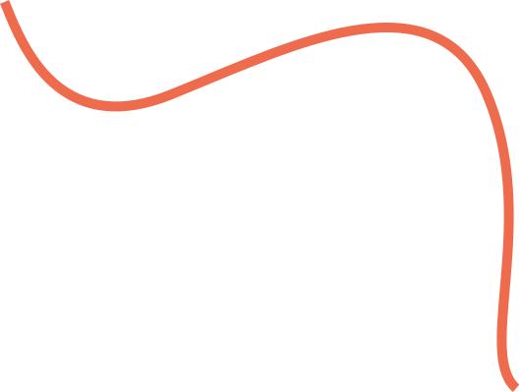


VERTICAL LINE TEST
5
4
3
2
1
Use the vertical line test to check whether a graph of a relation is a function.
-5
-4
-3
-2
-1
1
2
3
4
5
-1
-2
-3
If a vertical line, drawn anywhere on the graph, can touch the graph only once, then it is a function.
-4
-5

Slide 11




VERTICAL LINE TEST
5
4
3
2
1
If a vertical line, drawn anywhere on the graph, can touch the graph more than once, then the relation is not a function.
-5
-4
-3
-2
-1
1
2
3
4
5
-1
-2
-3
-4
-5

Slide 12



SUMMARY
A function is a special type of relation where each input only has one output.
Graphing a function using the table of values
Step 1: Construct the table of values.
Step 2: Plot the points on the coordinate plane.

Slide 13
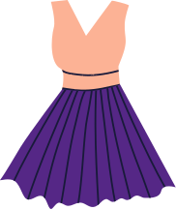
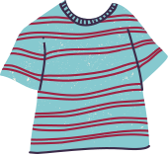



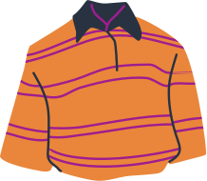
CLOSET COLORS!
Select 10 clothing items from your closet. Create a mapping diagram to record the colors to each of the clothing you have.
Then, find out if the information you collected represents a function or not.
Share your findings with the class next session.

Slide 14




REFERENCE
Mathspace. “6.0 Functions and relations | Grade 8 Math | Common Core 8 - 2023 Edition.” Accessed 12 June 2023,
https://mathspace.co/textbooks/syllabuses/Syllabus-1157/topics/Topic-21908/subtopics/Subtopic-279918/?searchString=

Slide 15









Resource Page
Use these design resources in your Canva Presentation.
You can find these fonts online too. Happy designing!
This presentation template uses the following free fonts:
Titles: Changa
Headers: Changa
Body Copy: Yantramanav

Slide 16

Credits
This presentation template is free for everyone to use thanks to the following:
SlidesCarnival for the presentation template
Pexels for the photos
Happy designing!

